Slide 1
Media Art Final Year Project 1
Intan Ferrlia Binti Ikram Shah
1141327595 - week 10

Slide 2
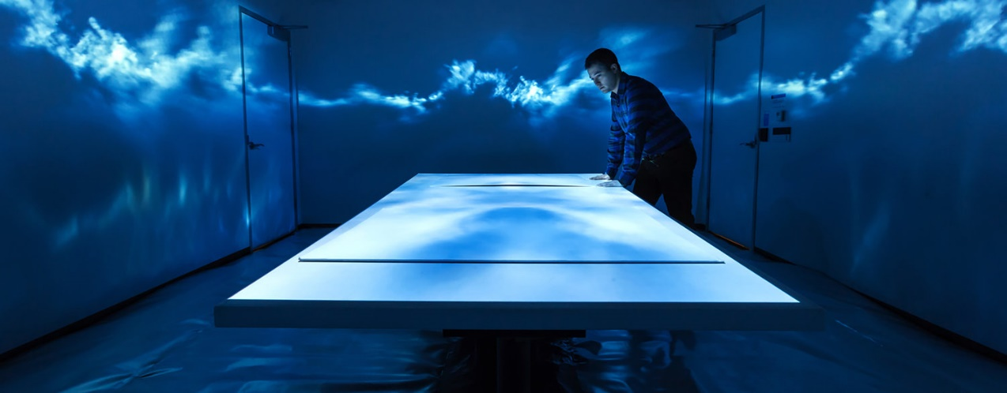
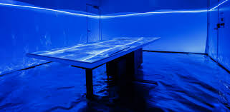
Case Study 1
https://m.youtube.com/watch?v=lhjIh8tOxUY
A panorama of Skies – Maja Petric (artist)
Hrvoje Benko( human- computer interaction researcher.

Slide 3
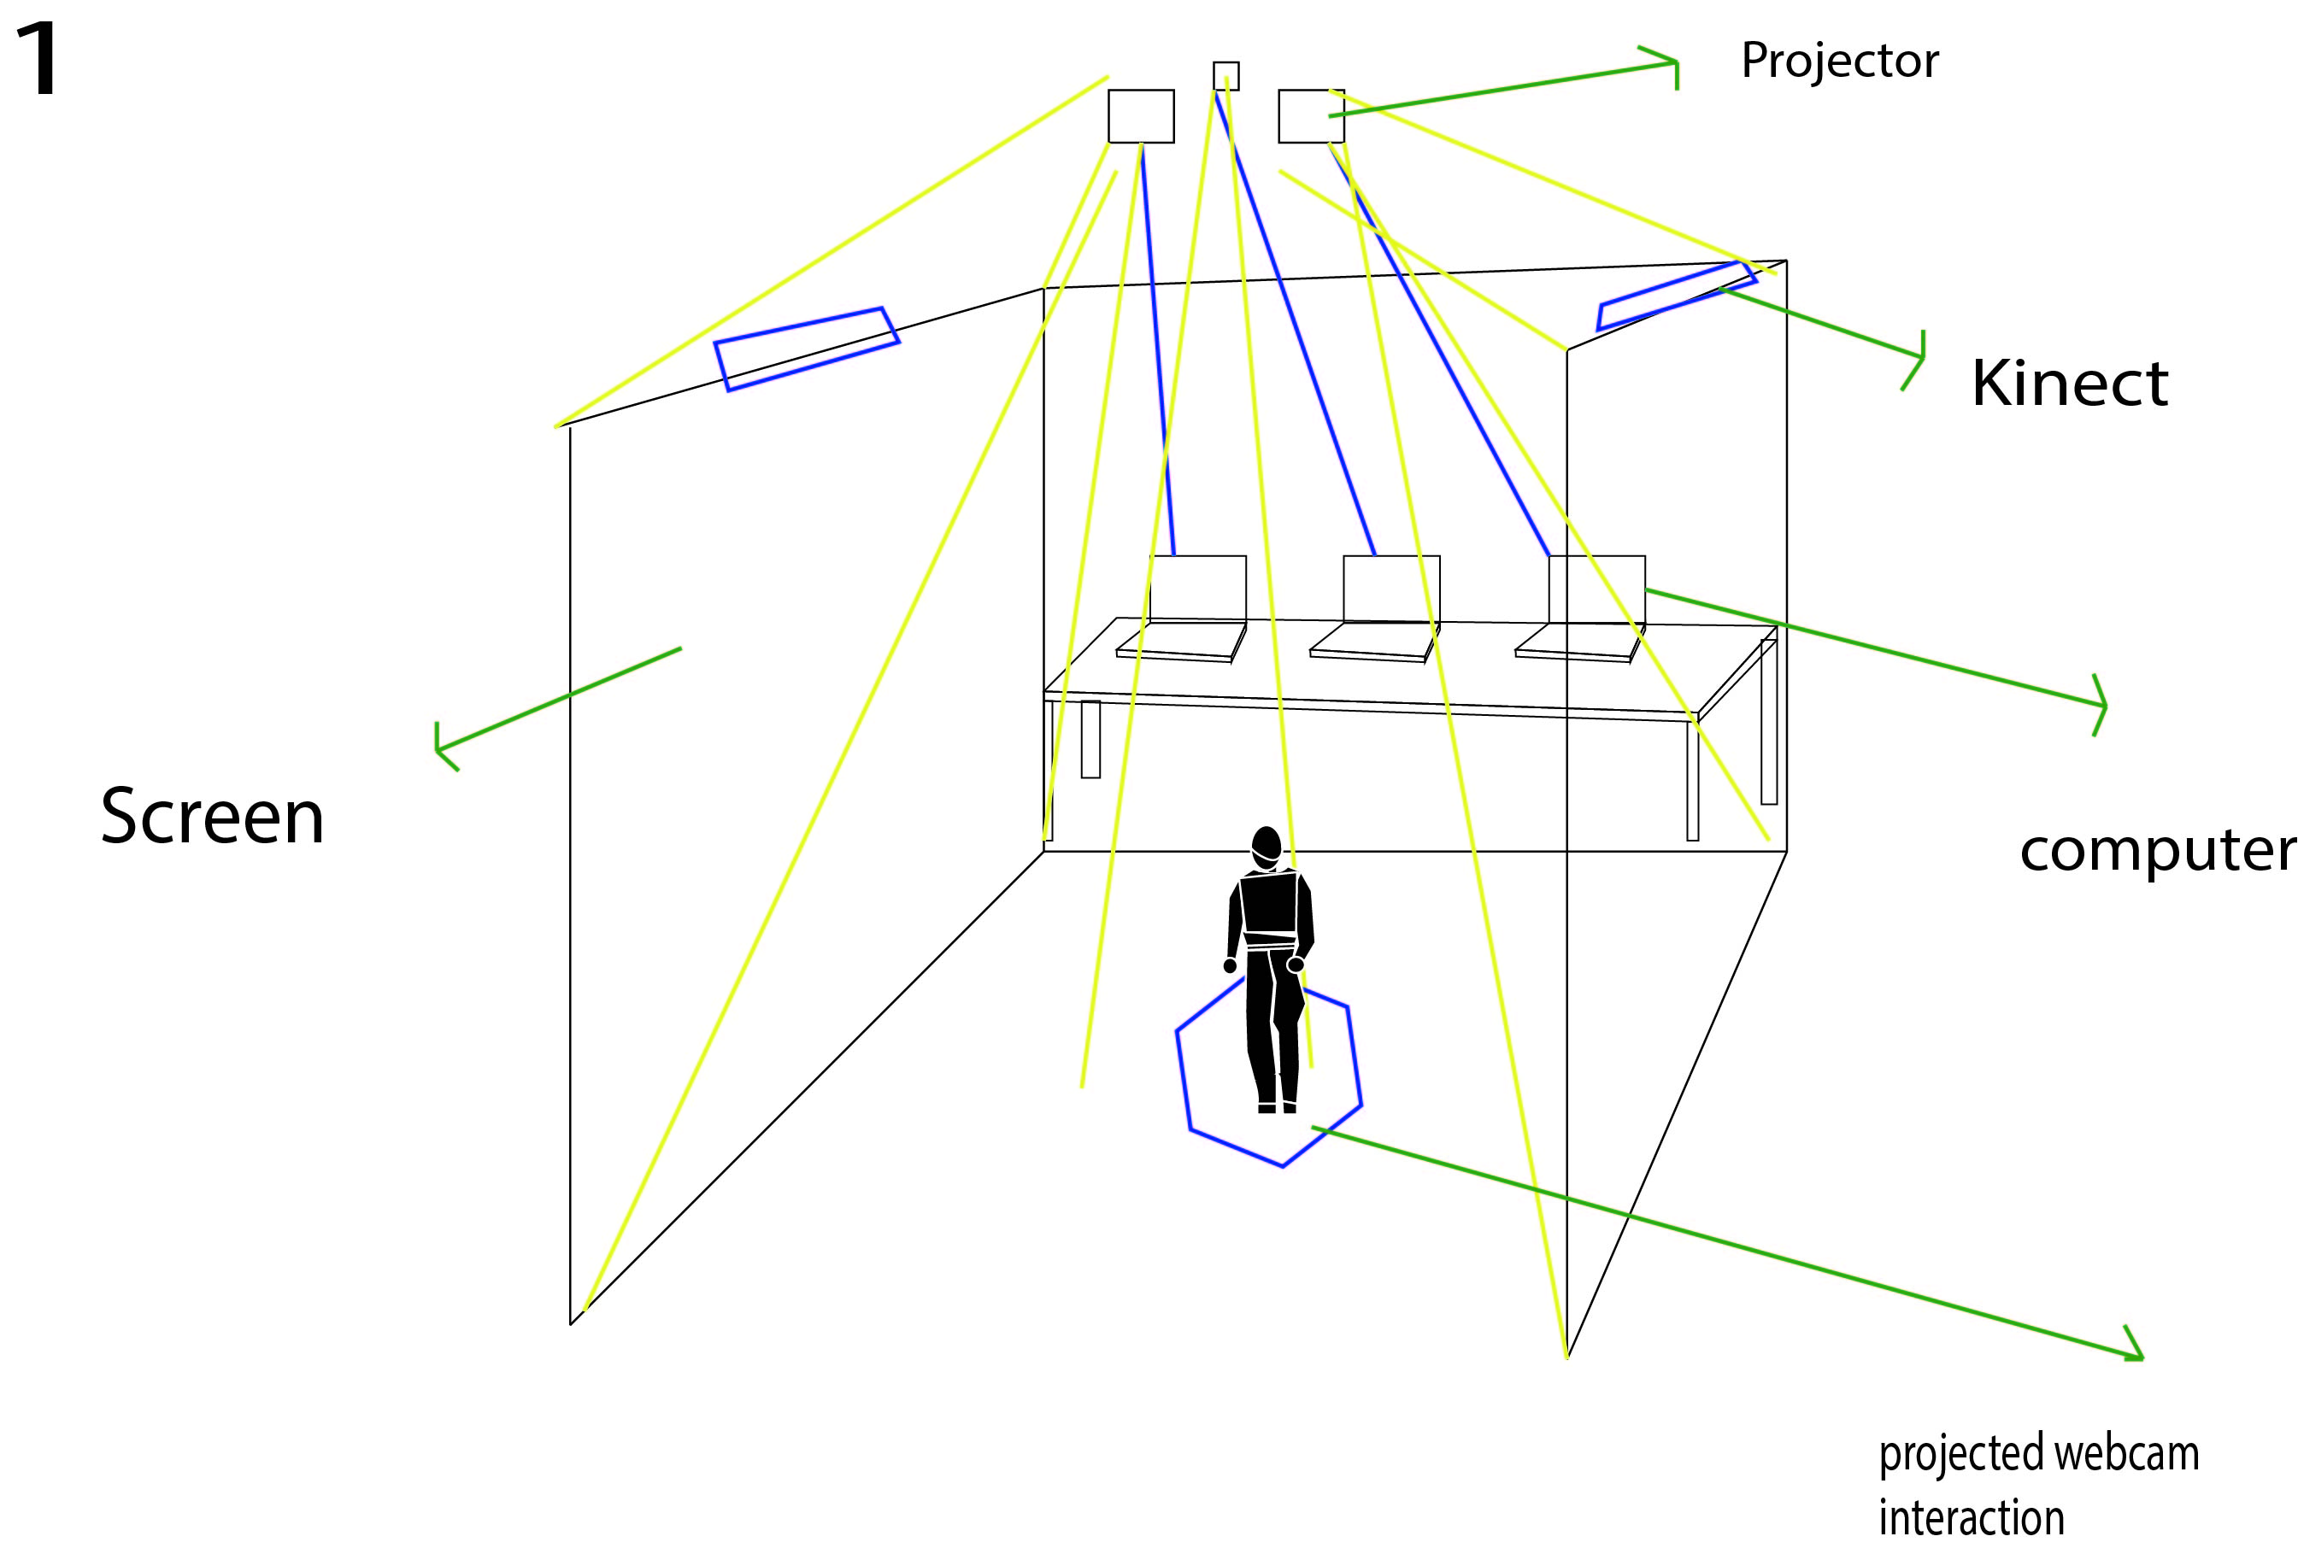
Floor Planning 1
Interaction Flow:
There will be 3 projector.
2 projector will
Project on the 2 wall each side
will have an interaction of
Kinect hand gesture of an
environment of glowing
various colour of roses
and Other element of nature.
The middle projection will do an interaction
Of changing rose colour by webcam movement
Interaction. (webcam detects movement of human)

Slide 4
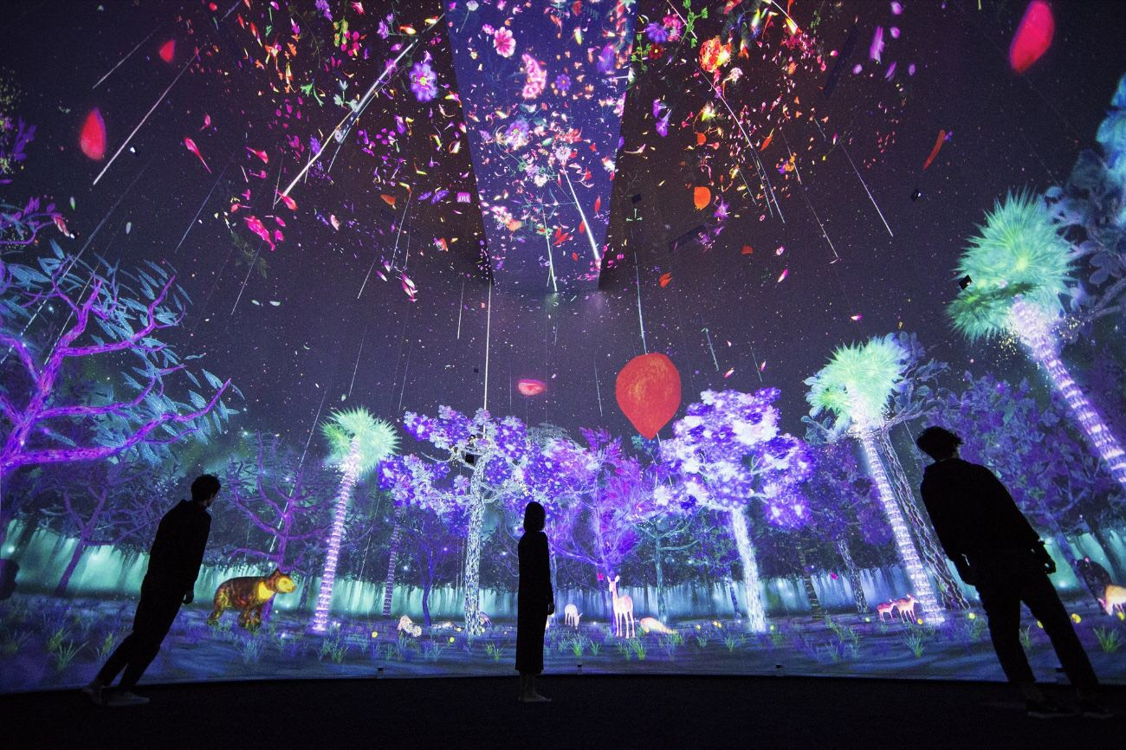
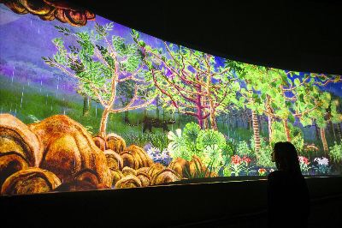
Case Study 2
https://www.teamlab.art/w/flowersbloom/

Slide 5
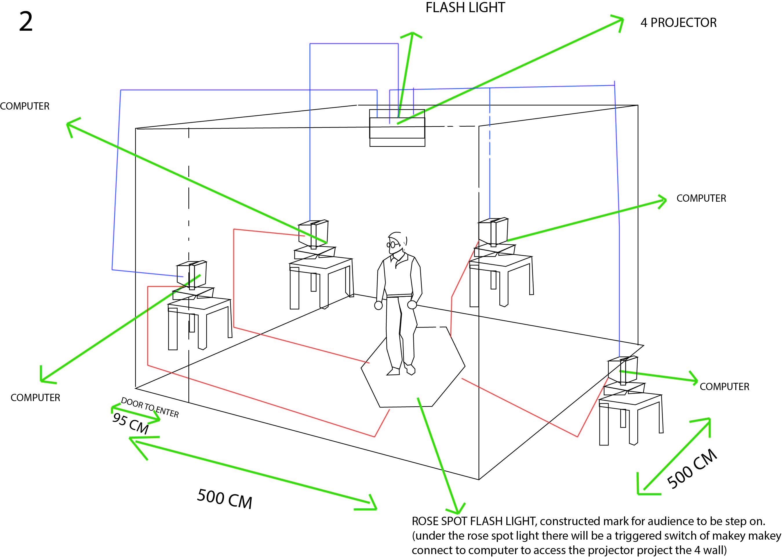
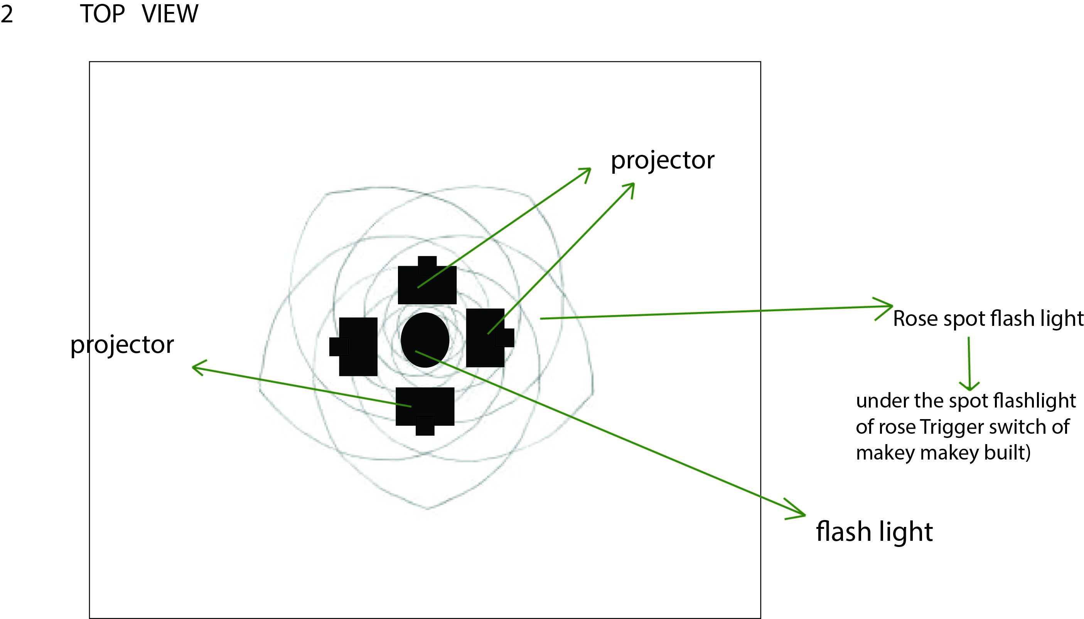
Floor Planning 2
Interaction Flow: Flash light / spot light with rose shape will be torch to the floor marked ,to leads the audience to step on it.
Under the marked floor is built a sensor touch. The sensor touch intractable of makey makey which allows
the computer to play a projected moving images of rose and other elements of environmet moving upward with sounds of
the nature living things to the 4 projected wall rooms.

Slide 6
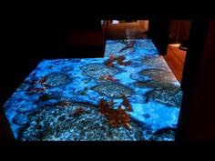
Case study 3
https://www.youtube.com/watch?v=mEip7TCbcfE&sns=em

Slide 7
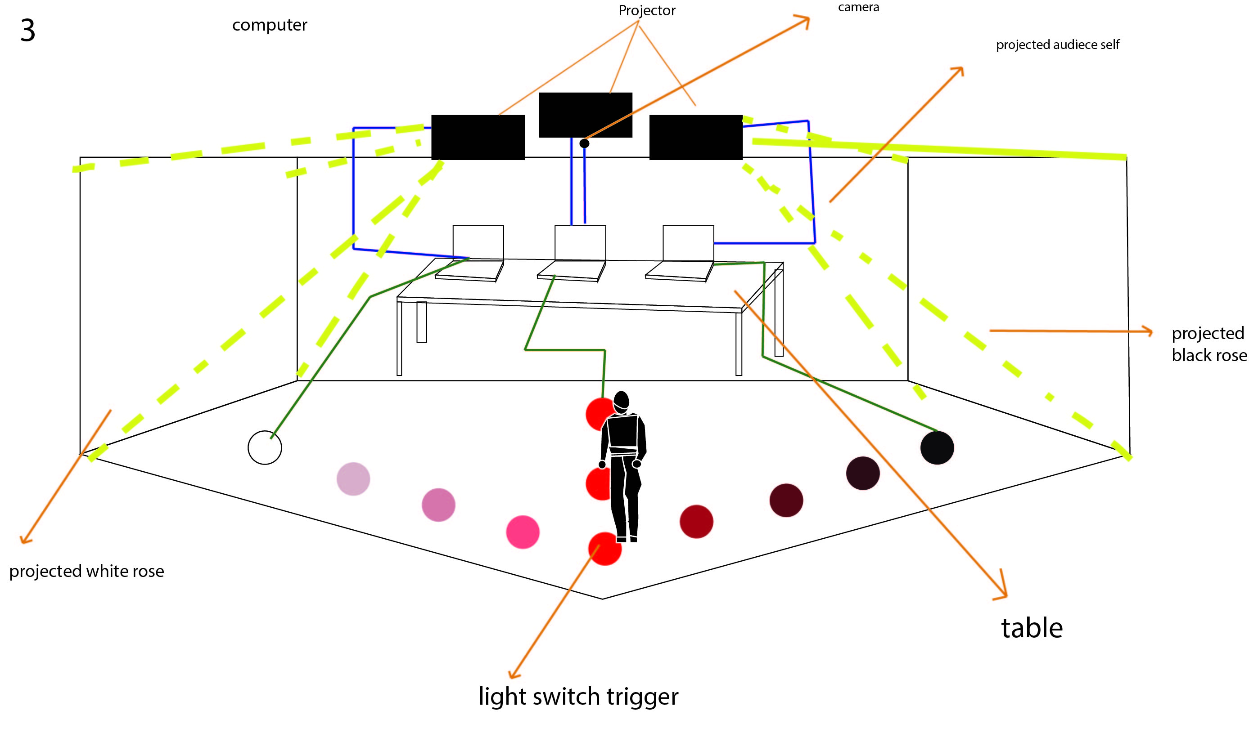
Floor Planning 3
Interaction Flow: The structured
Built with light trigger which,
Allow audience to choose three
Different path to steps on. The
Light will be light up during the
Steps. If the audience choose the
Path on the right at the last stops
The screen will show black rose
(to describe the dark vibes, tragic ,death
The path on the left will show
The red roses (to describe love
and appreciation).
The middle path will lead the audience to their own self
project. (to describe that we are our own self).

